Slide 1


Session 11
IO and Streams
Notes:
In a real sofware, files are ways to store data of a program. Data in a file can be binary bytes, characters, and even binary data of objects belonging to a specific class. Depending on storing formats, read from and write data to a file are different. So, the java.io package supplies APIs for managing directories and files.

Slide 2
Objectives
java.io package
  Text, UTF, and Unicode
  File Input and Output
  Streams, Readers, and Writers
  Object Streams and Serialization

Slide 3
Text, UTF, and Unicode
ASCII code
(8 bits)
256 characters
Character
Unicode
(16 bits)
65536 characters
( not completely represented)
Unicode character: a character is coded using 16/32 bits
UTF: Universal Character Set – UCS- Transformation Format
UTF: Unicode transformation format , a Standard for compressing strings of Unicode text .
UTF-8: A standard for compressing Unicode text to 8-bit code units.
Refer to: http://www.unicode.org/versions/Unicode7.0.0/
Java :
  Uses UTF to read/write Unicode
  Helps converting Unicode to external 8-bit encodings and vice versa.

Slide 4
Text files
Text (.txt) files are the simplest kind of files
  text files can be used by many different programs
Formatted text files (such as .doc files) also contain binary formatting information
Only programs that “know the secret code” can make sense formatted text files
Compilers, in general, work only with text.

Slide 5
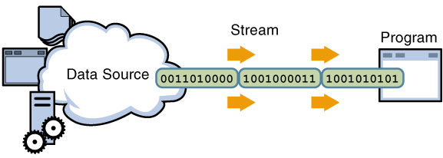
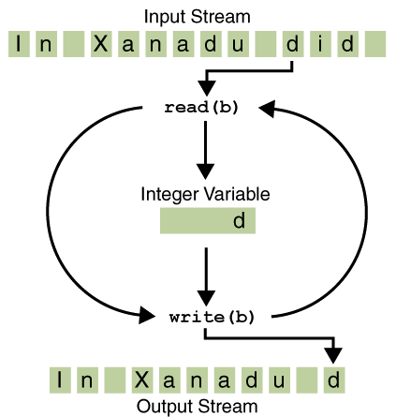
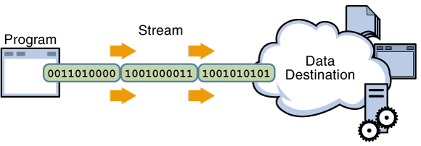
Streams (1)
A stream is an object managing a data source in which operations such as read data in the stream to a variable, write values of a variable to the stream associated with type conversions are performed automatically. These operations treat data as a chain of units (byte/character/data object) and data are processed in unit-by-unit manner.
Input stream
Output stream

Slide 6
Streams (2)
All modern I/O is stream-based
A stream is a connection to a source of data or to a destination for data (sometimes both)
An input stream may be associated with the keyboard
An input stream or an output stream may be associated with a file
Different streams have different characteristics:
  A file has a definite length, and therefore an end
  Keyboard input has no specific end

Slide 7
How to do I/O
import java.io.*;
Open the stream
Use the stream (read, write, or both)
Close the stream

Slide 8
Why Java I/O is hard
Java I/O is very powerful, with an overwhelming number of options
Any given kind of I/O is not particularly difficult
The trick is to find your way through the maze of possibilities
There is data external to your program that you want to get, or you want to put data somewhere outside your program
When you open a stream, you are making a connection to that external place
Once the connection is made, you forget about the external place and just use the stream

Slide 9
Example of opening a stream
A FileReader is a used to connect to a file that will be used for input:
  FileReader fr = new FileReader(fileName);
The fileName specifies where the (external) file is to be found
You never use fileName again; instead, you use fr
FileReader fr = new FileReader("test.txt");
int k; char c;
while(true) {
k = fr.read();
if(k == -1) break;
c = (char) k;
System.out.print(c);
}
fr.close();
The fr.read() method reads one character and returns it as an integer, or -1 if there are no more characters to read
The meaning of the integer depends on the file encoding (ASCII, Unicode, other)

Slide 10
Using a stream
Some streams can be used only for input, others only for output, still others for both
Using a stream means doing input from it or output to it
But it’s not usually that simple--you need to manipulate the data in some way as it comes in or goes out

Slide 11
Manipulating the input data
Reading characters as integers isn’t usually what you want to do
A BufferedReader will convert integers to characters; it can also read whole lines
The constructor for BufferedReader takes a FileReader parameter.
A BufferedReader will return null if there is nothing more to read.
FileReader fr = new FileReader("test.txt");
BufferedReader br = new BufferedReader(fr);
String s;
while((s = br.readLine()) != null) System.out.println(s);
fr.close();

Slide 12
Closing
A stream is an expensive resource
There is a limit on the number of streams that you can have open at one time
You should not have more than one stream open on the same file
You must close a stream before you can open it again
Always close your streams!

Slide 13
How did I figure that out?
I wanted to read lines from a file
I found a readLine method in the BufferedReader class
The constructor for BufferedReader takes a Reader as an argument
An InputStreamReader is a kind of Reader
A FileReader is a kind of InputStreamReader

Slide 14
The PrintWriter class
PrintWriter pw = new PrintWriter("test.txt");
int k = 5; float x = 12.7f; double y = 23.83;
pw.write("Hello\r\n");
pw.println("k = " + k);
pw.println("x = " + x);
pw.println("y = " + y);
pw.flush();
pw.close();
Buffers are automatically flushed when the program ends normally
Usually it is your responsibility to flush buffers if the program does not end normally
PrintWriter can do the flushing for you.
Notes:
flushed L Làm sạch

Slide 15
File and RandomAccessFile classes
Java’s java.io.File and java.io.RandomAccessFile classes provide functionality for navigating the local file system, describing files and directories, and accessing files in non-sequential order.

Slide 16
The File Class
File class represents the name of a file or directory that might exist on the host machine’s file system.
Ctor:
  File(String pathname);
Constructing an instance of File does not create a file on the local file system.

Slide 17
File methods
boolean exists().
String getAbsolutePath()
String getCanonicalPath()
String getName()
String getParent()
boolean isDirectory()
boolean isFile()
String[] list()
boolean canRead()
boolean canWrite()
boolean createNewFile()
boolean delete()
long length()
boolean mkdir()
boolean renameTo(File newname )

Slide 18
File examples
File f = new File(fname);
if(f.exists())
System.out.println("The file " + fname + " exists");
else
System.out.println("The file " + fname + " does not exist");
if(!f.exists()) f.createNewFile();
if(!f.exists()) f.delete();
File f = new File("data");
if(!f. isDirectory()) f.mkdir();

Slide 19
The RandomAccessFile Class
With a random-access file, you can seek to a desired position within a file and then read or write a desired amount of data.
The RandomAccessFile class provides methods that support seeking, reading, and writing.

Slide 20
RandomAccessFile consructors
RandomAccessFile(String file, String mode)
RandomAccessFile(File file, String mode)
Where:
mode: should be either “r” or “rw”. Use “r” to open the file for reading only, and use “rw” to open for both reading and writing.

Slide 21
RandomAccessFile…
RAF offer the following functionality:
  Seeking to any position within a file
  Reading and writing single or multiple bytes
  Reading and writing groups of bytes, treated as higher-level data types
  Closing

Slide 22
RandomAccessFile methods
long getFilePointer()
long length()
void seek(long position)
int read()
int read(byte dest[])
int read(byte dest[], int offset, int len)
void write(int b)
void write(byte b[])
void write(byte b[],int offset, int len)
void writeBytes(String s)
void close() throws IOException

Slide 23
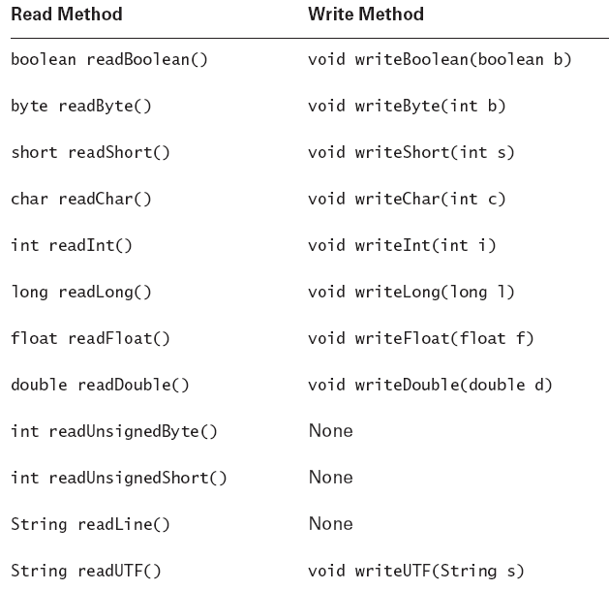
RandomAccessFile methods…

Slide 24
RandomAccessFile examples (1)
RandomAccessFile f = new RandomAccessFile("test.txt","rw");
f.writeInt(5);
f.writeDouble(15.5);
f.writeBytes("ABC XYZ");
f.close();
f = new RandomAccessFile("test.txt","r");
int k; double x;String s;
k = f.readInt();
x = f.readDouble();
s = f.readLine();
f.close();

Slide 25
RandomAccessFile examples (2)
RandomAccessFile f = new RandomAccessFile("emp.txt","r");
String [] a; String s; int k; double y; Emp x;
while(true)
{s = f.readLine();
if(s==null || s.length()<4) break;
a = s.split("\\s*\\|\\s*");
if(a==null || a.length<4) break;
k = Integer.parseInt(a[2]);
y = Double.parseDouble(a[3]);
x = new Emp(a[0],a[1],k,y);
t.add(x);
}
f.close();
A | Hoa | 19 | 500
C | La | 21 | 450
D | Canh | 18 | 300
B | Cay | 22 | 350

Slide 26
Streams, Readers, and Writers
Java’s stream, reader, and writer classes view input and output as ordered sequences of bytes.
Dealing strictly with bytes would be tremendously bothersome, because data appears sometimes as bytes, sometimes as ints, sometimes as floats, and so on.

Slide 27
Output
  A low-level output stream receives bytes and writes bytes to an output device.
  A high-level filter output stream receives general-format data, such as primitives, and writes bytes to a low-level output stream or to another filter output stream.
  A writer is similar to a filter output stream but is specialized for writing Java strings in units of Unicode characters.

Slide 28
Input
  A low-level input stream reads bytes from an input device and returns bytes to its caller.
  A high-level filter input stream reads bytes from a low-level input stream, or from another filter input stream, and returns general-format data to its caller.
  A reader is similar to a filter input stream but is specialized for reading UTF strings in units of Unicode characters.

Slide 29
Low-Level Streams
Low-level input streams
  FileInputStream
  ByteArrayInputStream
  ..
Low-level output streams
  FileOutputStream
  ByteArrayOutputStream
  …

Slide 30
FileInputStream..
byte b;
byte bytes[] = new byte[100];
byte morebytes[] = new byte[50];
try {
  FileInputStream fis = new FileInputStream(“fname”);
  b = (byte) fis.read(); // Single byte
  fis.read(bytes); // Fill the array
  fis.read(morebytes, 0, 20); // 1st 20 elements
  fis.close();
}
catch (IOException e) { }

Slide 31
High-Level Streams
The most common of these extend from the superclasses FilterInputStream and
FilterOutputStream.
Do not read/write from input/output devices such as files or sockets; rather, they read/write from other streams.

Slide 32
High-Level Streams…
DataInputStream
DataOutputStream
BufferedInputStream
BufferedOutputStream
….

Slide 33
DataInputStream Sample
try {
  // Construct the chain
  FileInputStream fis = new FileInputStream(“fname”);
  DataInputStream dis = new DataInputStream(fis);
  // Read
  double d = dis.readDouble();
  int i = dis.readInt();
  String s = dis.readUTF();
  // Close the chain
  dis.close(); // Close dis first, because it
  fis.close(); // was created last
}
catch (IOException e) {

Slide 34
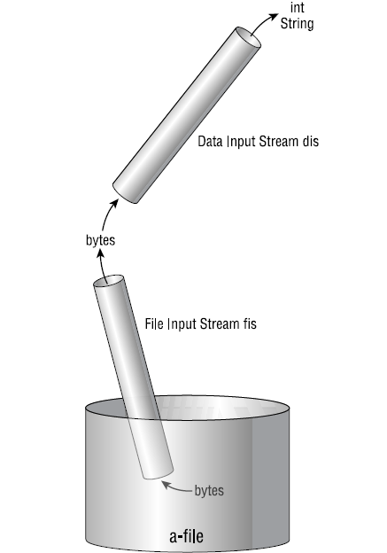
A chain of input streams

Slide 35
Readers and Writers
Readers and writers are like input and output streams: The low-level varieties communicate with I/O devices, and the high-level varieties communicate with low-level varieties.
Readers and writers are exclusively oriented to Unicode characters.

Slide 36
Readers and Writers..
FileReader and FileWriter
CharArrayReader and CharArrayWriter
PipedReader and PipedWriter
StringReader and StringWriter
BufferedReader and BufferedWriter
InputStreamReader and OutputStreamWriter
LineNumberReader
..

Slide 37
Object Streams and Serialization
Object streams go one step beyond data streams by allowing you to read and write entire objects.

Slide 38
Serialization
You can also read and write objects to files
Object I/O goes by the awkward name of serialization
Serialization in other languages can be very difficult, because objects may contain references to other objects
Java makes serialization (almost) easy

Slide 39
Conditions for serializability
If an object is to be serialized:
  The class must be declared as public
  The class must implement Serializable interface
  The class must have a no-argument constructor
  All fields of the class must be serializable: either primitive types or serializable objects (static fields and transient fields are also not serialized)

Slide 40
Implementing the Serializable interface
To “implement” an interface means to define all the methods declared by that interface, but...
The Serializable interface does not define any methods!
  Question: What possible use is there for an interface that does not declare any methods?
  Answer: Serializable is used as flag to tell Java it needs to do extra work with this class

Slide 41
Writing objects to a file
ObjectOutputStream ou =
new ObjectOutputStream(
new BufferedOutputStream(
new FileOutputStream(fileName)));
ou.writeObject(serializableObject);
ou.close( );

Slide 42
Reading objects from a file
(De-serialization)
ObjectInputStream obIn =
new ObjectInputStream(
new BufferedInputStream(
new FileInputStream(fileName)));
myObject = (itsType)obIn.readObject( );
obIn.close( );

Slide 43
What have I left out?
Encrypted files, compressed files, files sent over internet connections, ...
Exceptions! All I/O involves Exceptions!
try { statements involving I/O }
catch (IOException e) {
e.printStackTrace ( );
}

Slide 44
Summary
java.io package
  Text, UTF, and Unicode
  File Input and Output
  Streams, Readers, and Writers
  Object Streams and Serialization
Q&A

